Slide 1
Welcome
WCBC Annual Business Meeting
February 5, 2024

Slide 2
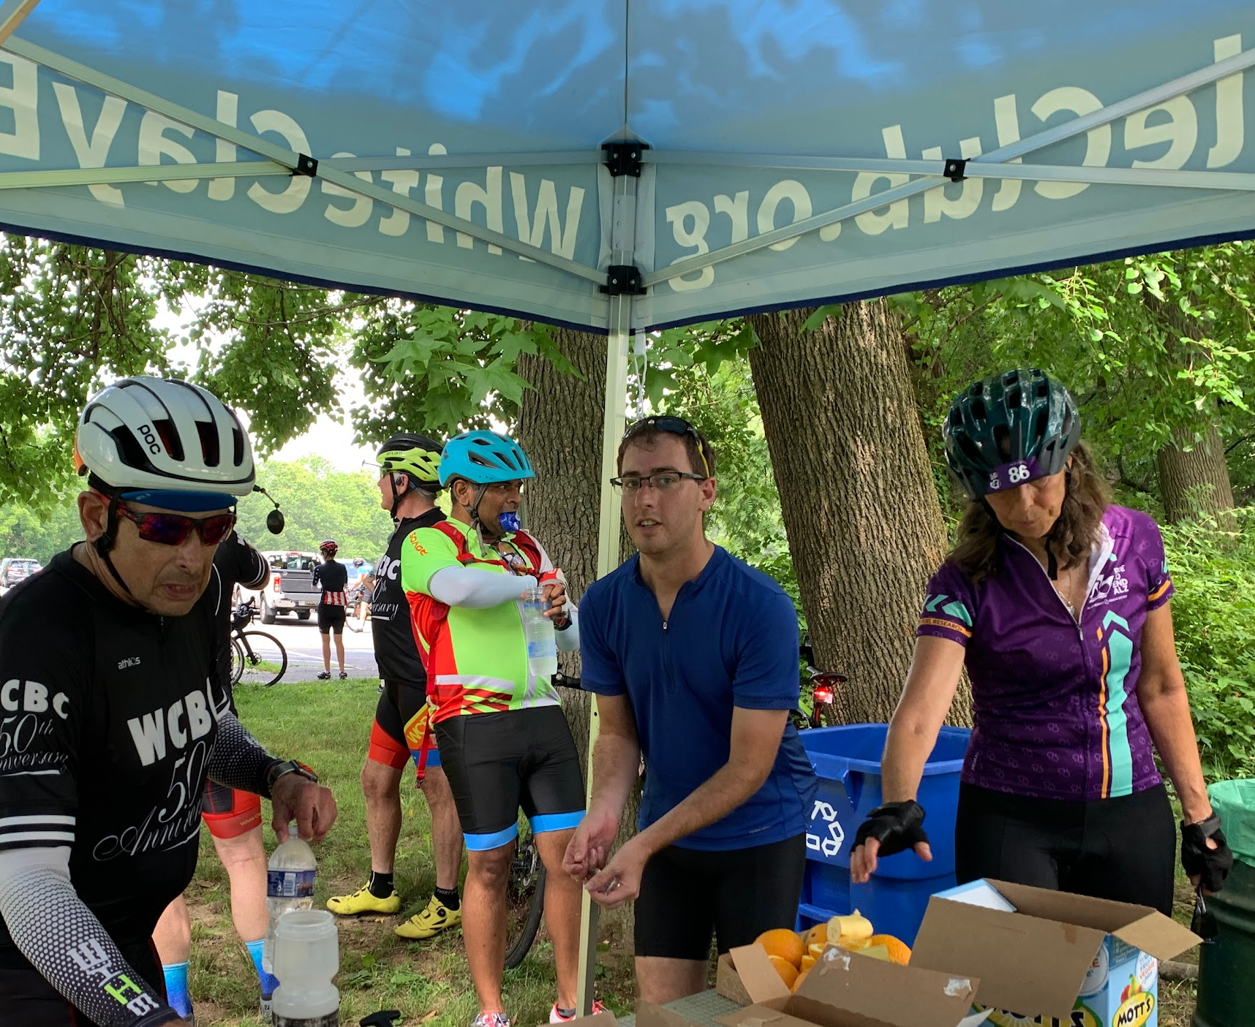
2023 Activities
Coordinated 5 major supported ride events
Highlighted Club’s legacy with year-long 50th Anniversary celebration
Performed major website revamp
Continued Ride Calendar activities
Donated to 7 cycling advocacy organizations
Conducted 5 major ride surveys and 1 membership survey
Recognized volunteers at fall brunch/ride
Reconfigured some Executive Committee positions/responsibilities
Displayed WCBC table at Bike Delaware Summit
Represented WCBC at JAM extension ribbon cutting

Slide 3
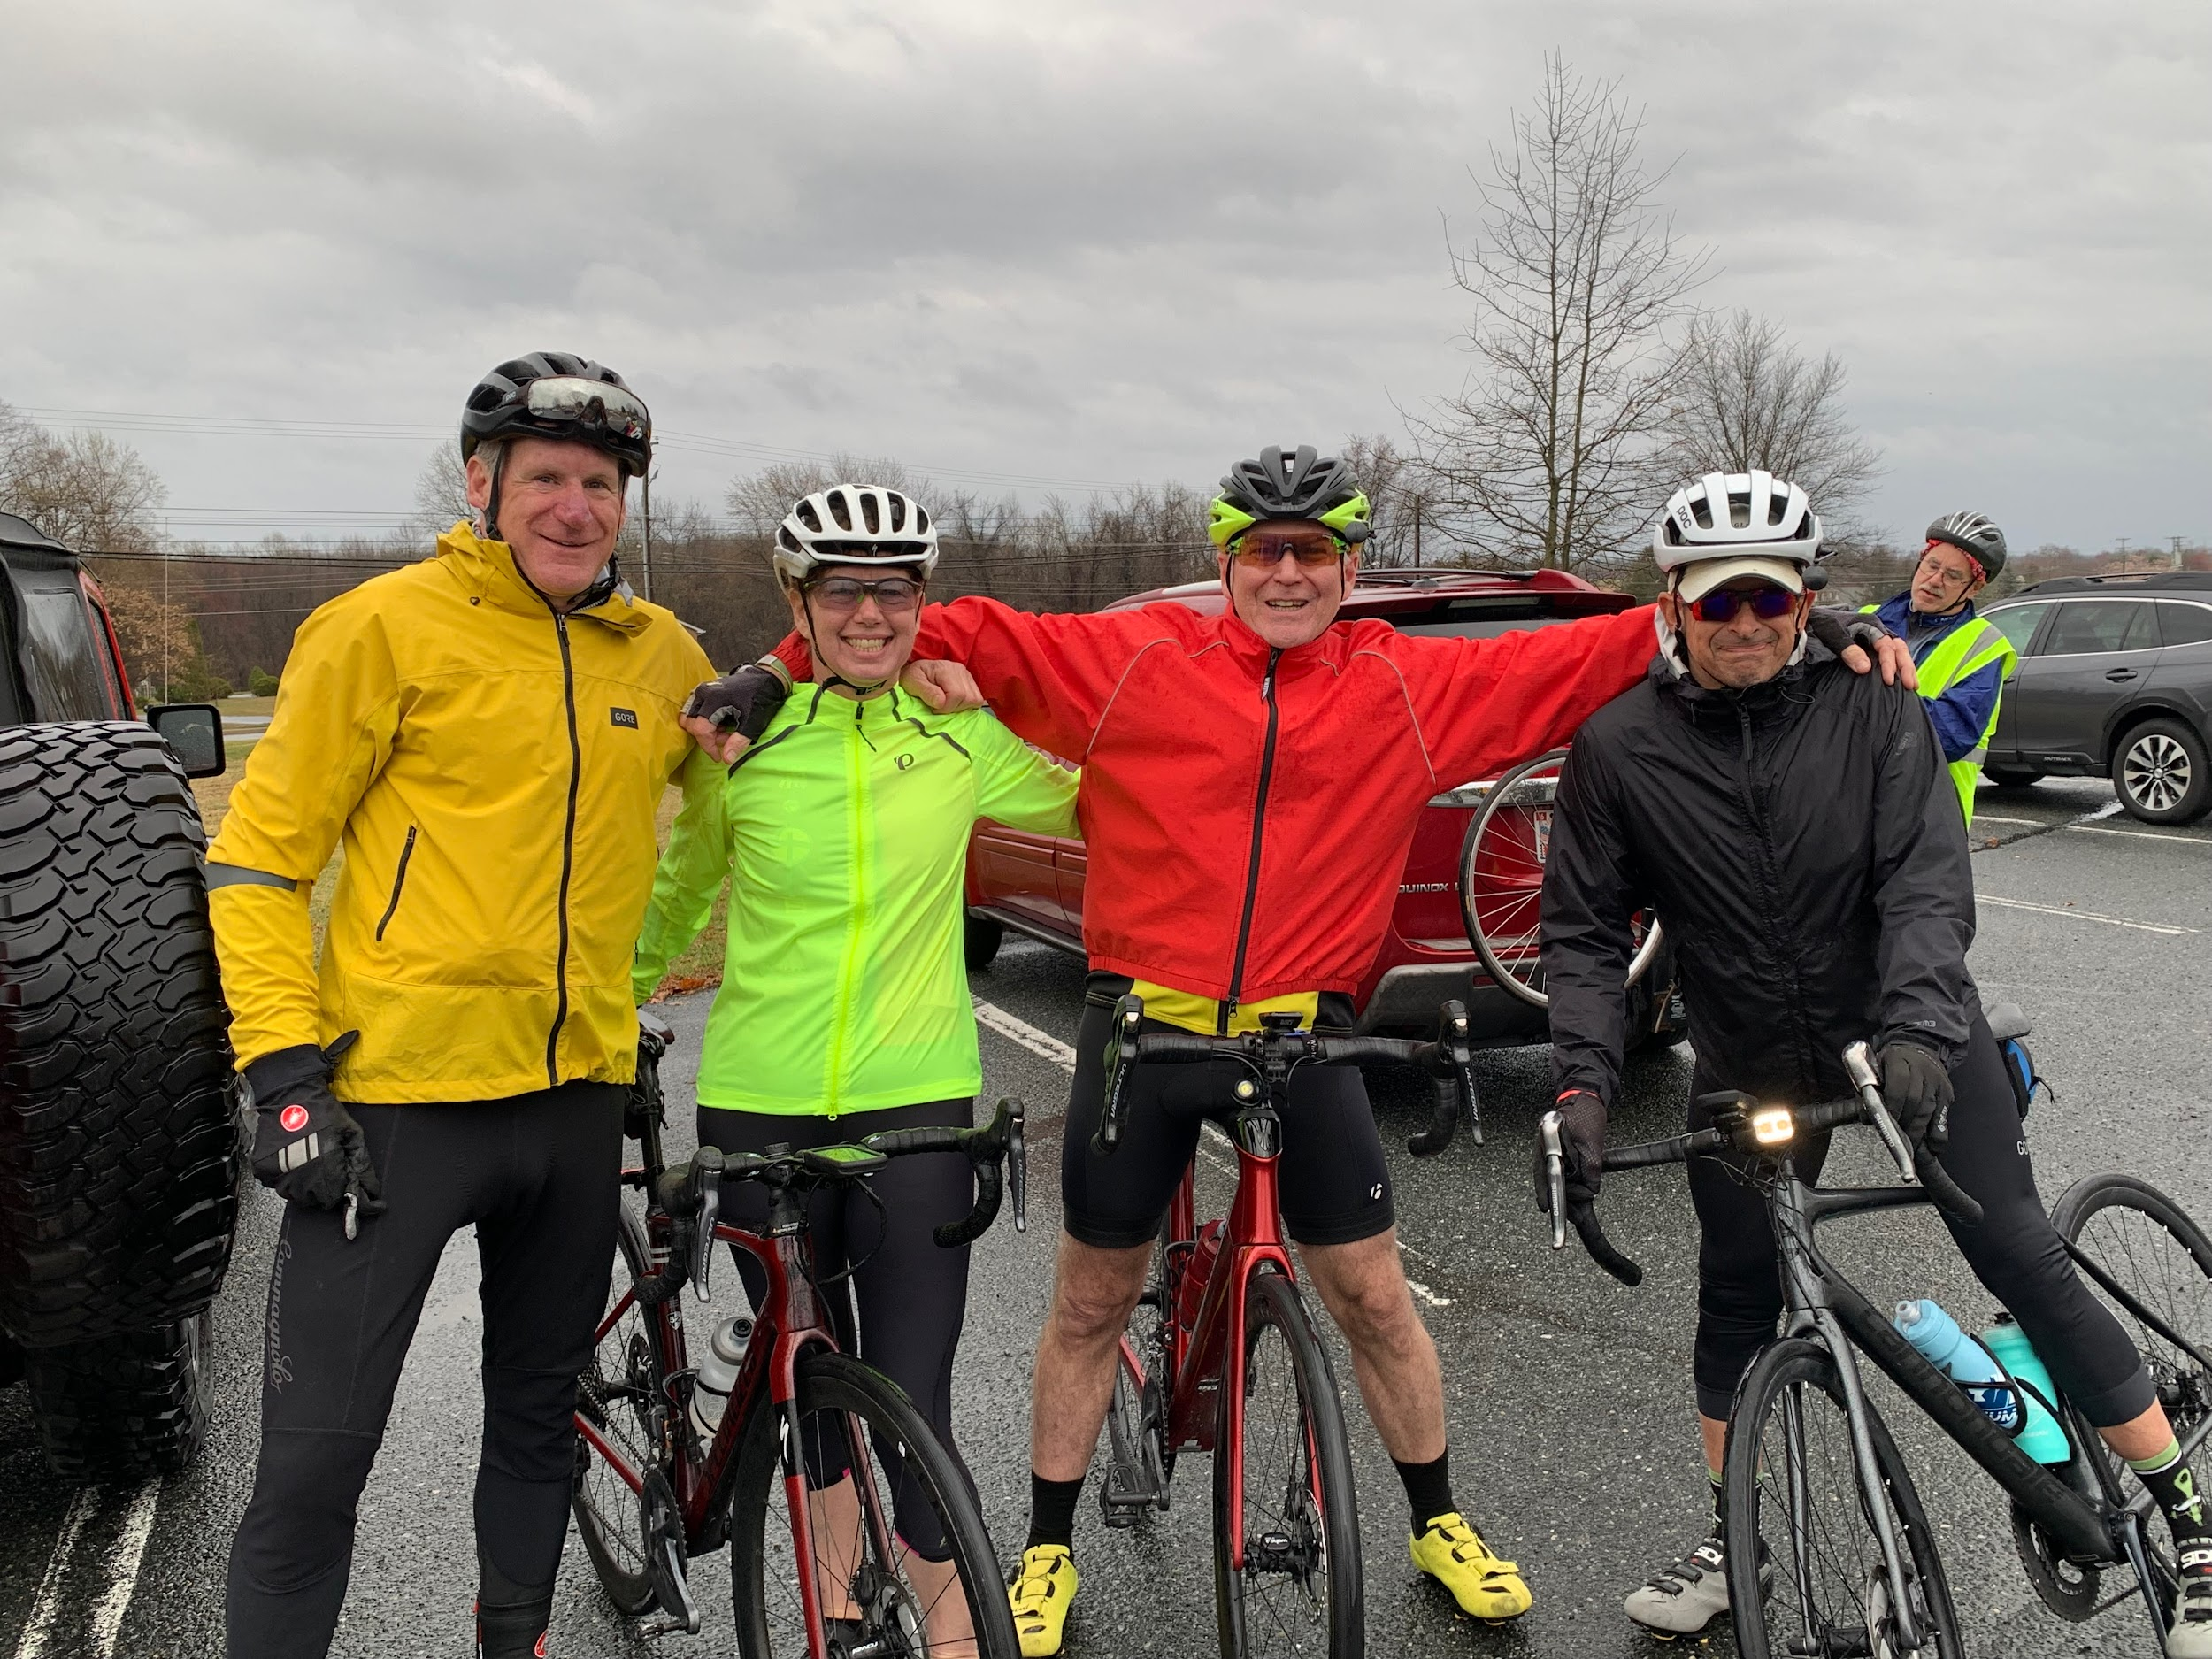
2023 Challenges
Finances
Leadership vacancies
Weather

Slide 4
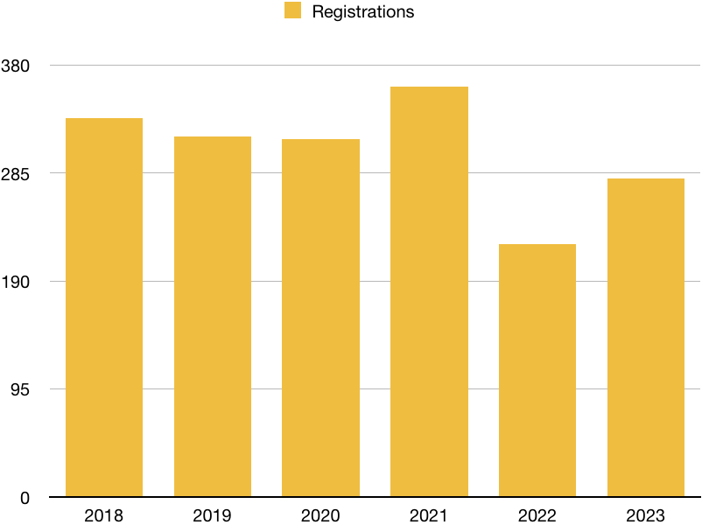
Membership via BikeReg

Slide 5
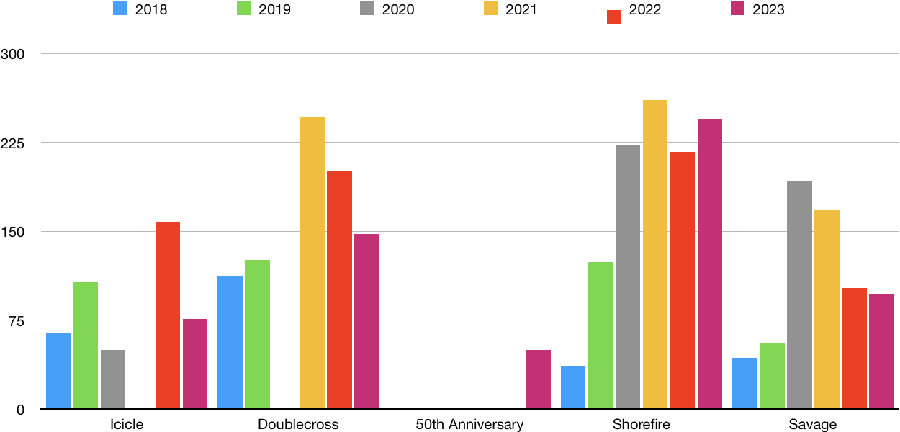
Supported Event Participation

Slide 6
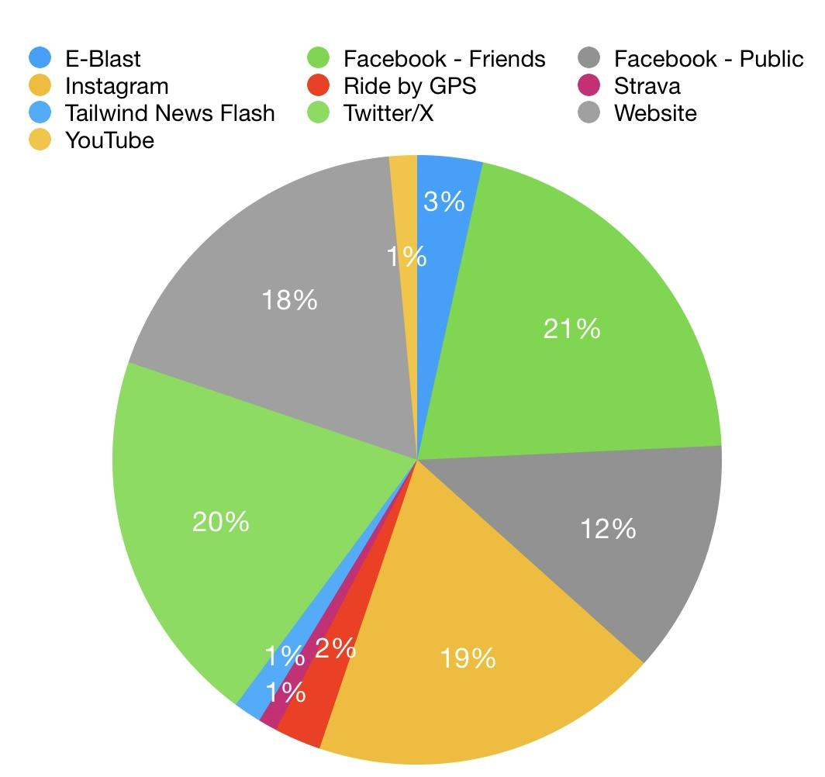
Communications Methods

Slide 7
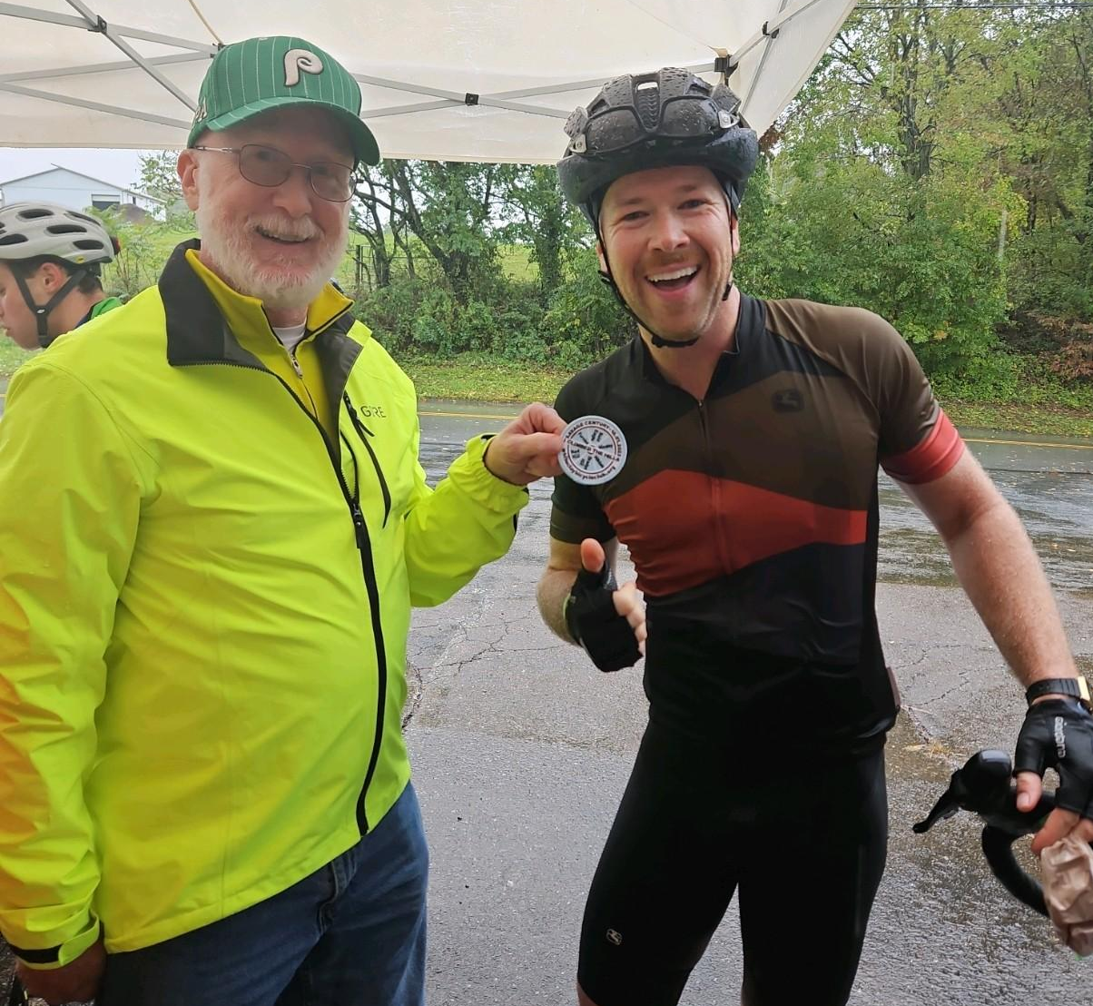
2024 Plans & Goals
Act on results/recommendations from 2023 surveys
Run 4 major supported ride events
Increase scheduled Calendar Rides
Grow membership
Participate in Ride of Silence
Train new Ride Leaders
Host Club member summer picnic
Recognize volunteers at fall brunch
Launch theme of Ride Together
Create Club Discord community
Finetune Executive Committee members’ responsibilities
Continue updating website material

Slide 8
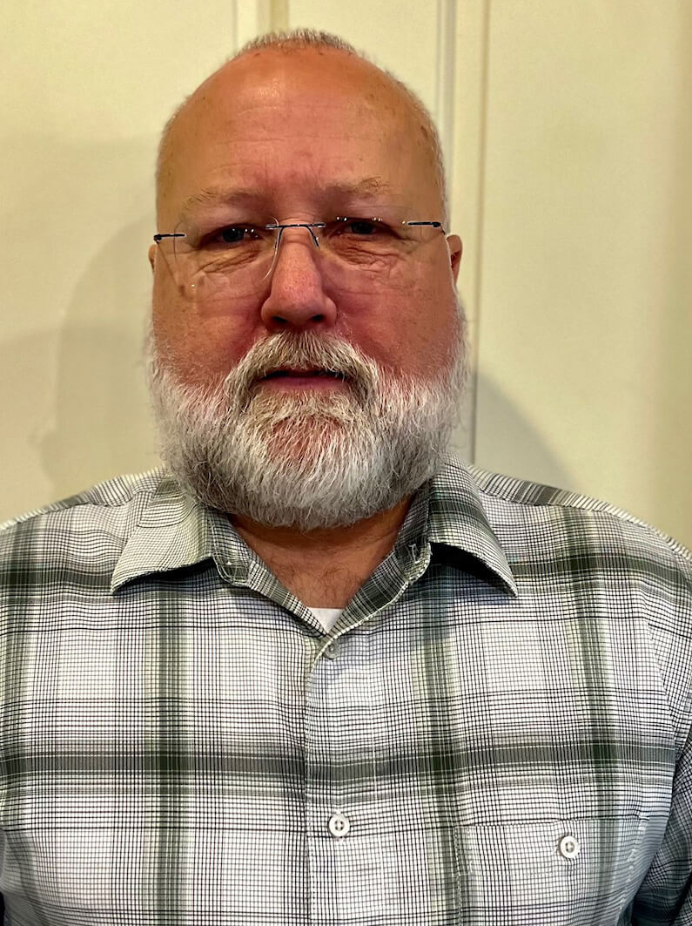
Service Awards
Mark Belmont
Rita Law
Holly Maddams

Slide 9
Distinguished Service Award
Bill Ebbott

Slide 10
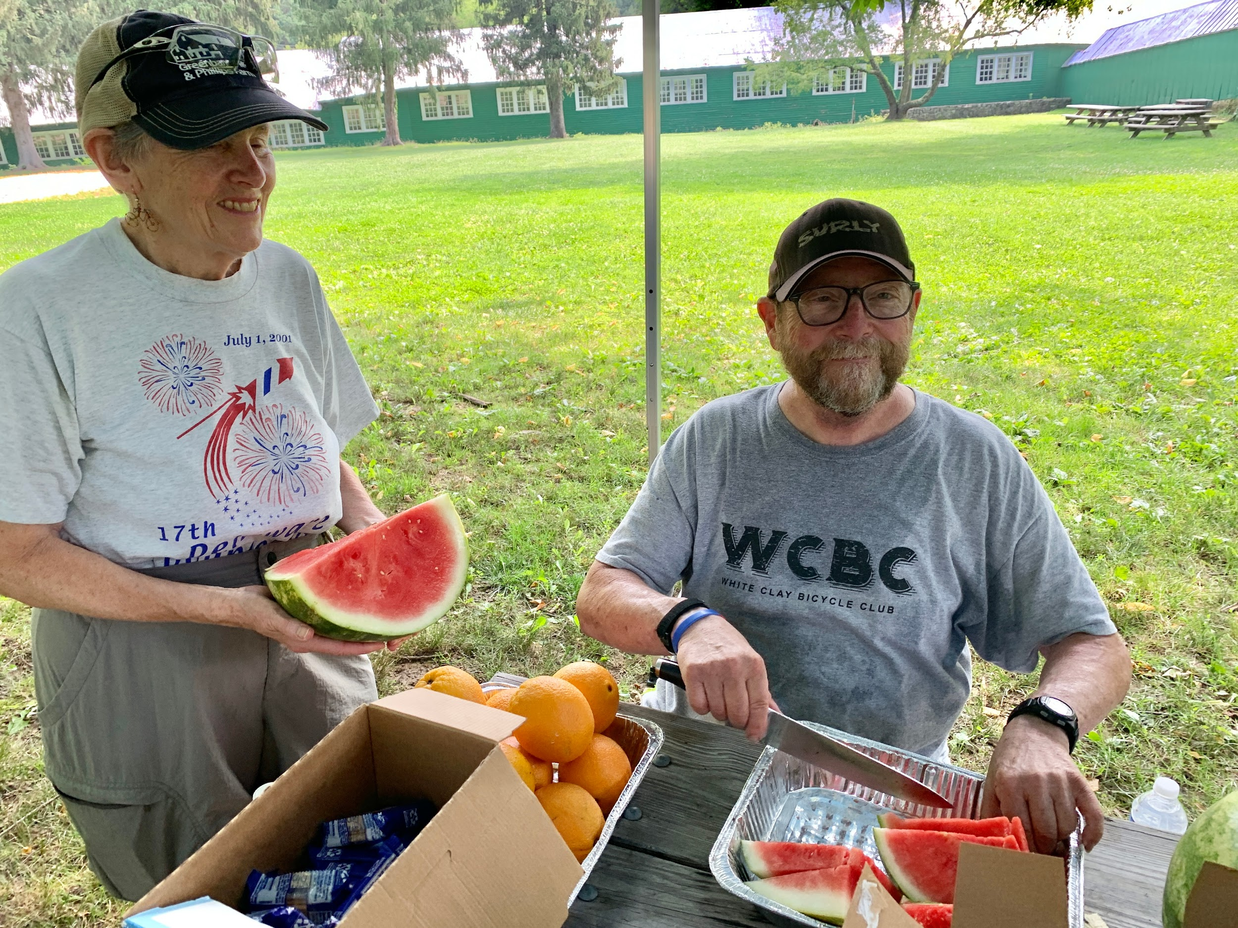
Many Thanks to Our 2023 Volunteers
Tom Brazill
Jeff Bricker
Diane Burns
Deanna Cain
Gary Cain
Bob Conley
Jaymi Cook
Christine Cornish
Kim Corrigan
Mary Cressman
Brian Donovan
Brian Dougherty
Bill Ebbott
Barb Gallagher
Jay Gallagher
Larry Galpin
Karl Hassler
JW Haupt
April Hogan
Tom Hunnum
Carol Ireland
Denise Johnson
Randy Kunkle
Mike Katz
Rita Law
Don Lyons
Lonni Lehman
Holly Maddams
Carol MacQueen
Robert McBride
Stephanie McBride
Ceci McCormick
John McCormick
Jeff Miller
Suzanne Mitchell
Ed McNulty
Susan McNulty
Dinesh Mistry
Glenn Nichols
Thalia Pappas
Rahul Patil
Yvonne Patterson
Jeff Phillips
Ty Phillips
Jamie Plower
Frank Romedio
José Rodríguez
Brigitte Sheehan
Jay Sladewski
Gail Schneiders
Carl Stevens
Bob Stover
James Wilson

Slide 11
Ride Leaders
Ride Leader #
Barb Gallagher 7
Tom Brazil 7
Jon Ripson 6
Holly Maddams 5
Jose Rodriguez 4
Mark Hitchcock 3
George Holoman 3
Richard Fernandes 3
Deanna Cain 2
Dan O'Hara 1
Glenn Nichols 1
Jaymi Cook 1
Stephen Arnold 1
Jeremy Butler 1
Franz Kappel 1
Ride Leader #
Brian Donovan 41
Jay Gallagher 35
Patrick Karani 32
Bill Ebbott 31
Mike Wilde 30
JW Haupt 30
Natalie Zemaitis 24
Rita Law 21
Jim Broscious 19
Brian Albin 18
Emily Ciancio 17
Jeff Manlove 12
Mary Cressman 11
Jeff Bricker 10

Slide 12
Major Ride Event Coordinators
Brian Donovan Icicle Metric
Fred Hartman Doublecross Metric
Bill Ebbott 50th Anniversary Tour
Bill Ebbott Shorefire Century
Dinesh Mistry Savage Century

Slide 13
WCBC Executive Committee Election Finals
Deanna Cain | President/Communications
Bill Ebbott | VP/Major Ride Director/Shorefire Chair
Marty Lessner | Treasurer
Brian Donovan | Icicle Chair
Fred Hartman | Doublecross Chair
Mike Katz | Safety & Education Chair
TBA | Ride Captain
TBA | Social Group Activities Chair
Dinesh Mistry | Savage Chair
Allison Wong | Webmaster

Slide 14
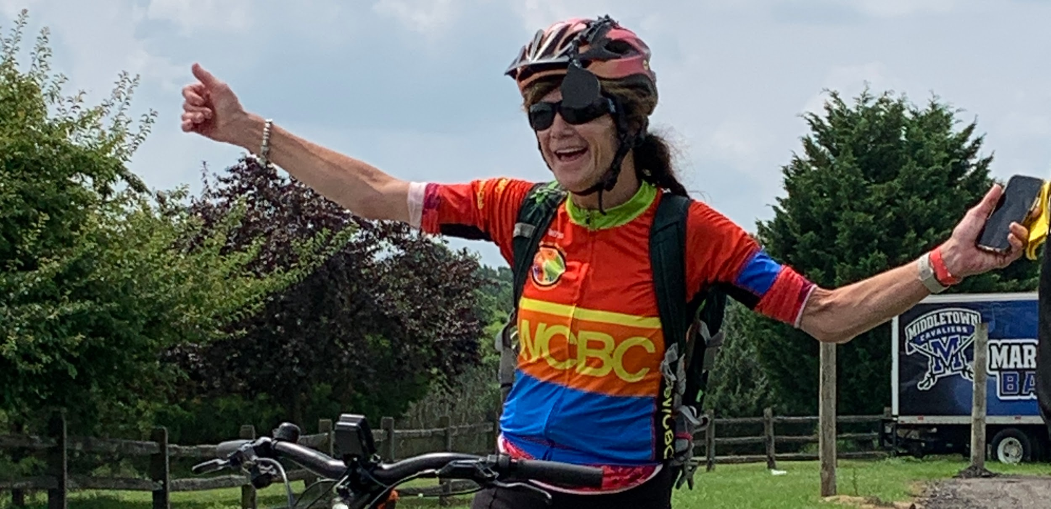
Questions?

Slide 15
Let’s Ride Together!

